Slide 1

Virtual cfo

Slide 2

What is Virtual cfo
Virtual CFO (or VCFO for short) stands for Virtual Chief Financial Officer. A virtual CFO is an outsourced service provider offering high skill assistance in financial requirements of an organization, just like a chief financial officer does for large organizations. A virtual CFO may be a single person or an entity.
The Virtual CFO is a new concept. It's a way for small businesses to get CFO support that they wouldn't have been able to afford previously.
Small businesses that hire a virtual CFO get access to an experienced financial professional at a fraction of the cost of a full-time CFO.

Slide 3
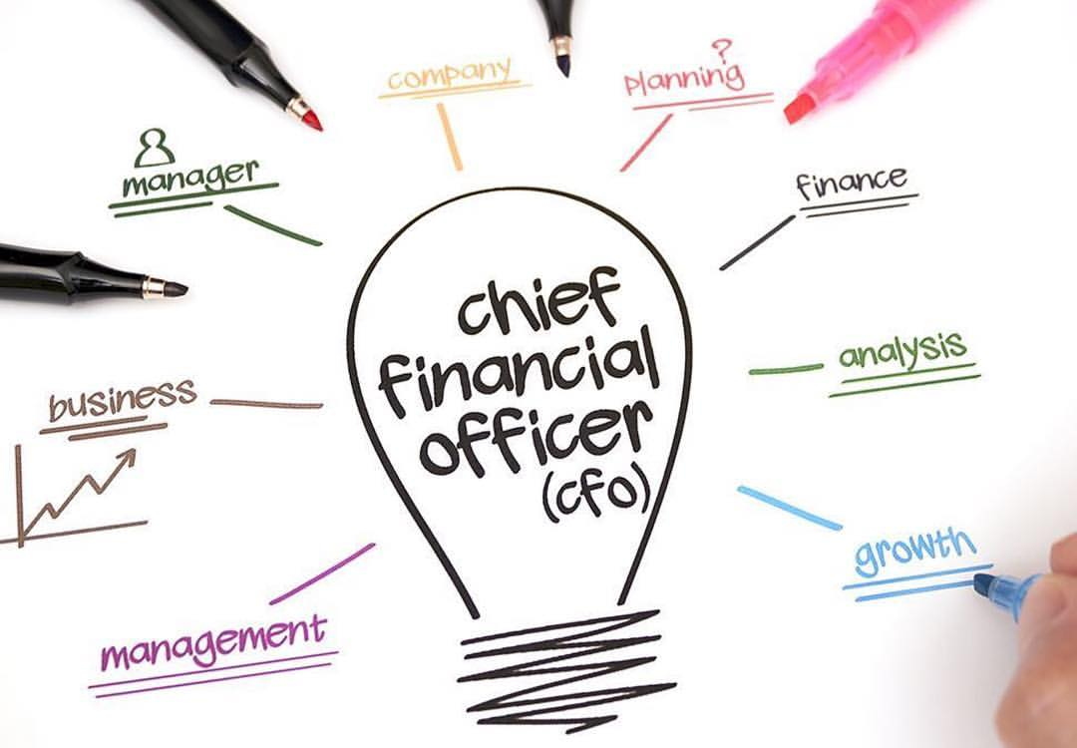

Slide 4

What services does a VCFO provide?
Management reporting and dashboard reporting
Cashflow modelling, reporting and management
Budget and forecasting preparation, analysis and tracking
Finance process reviews
Cloud accounting advice

Slide 5
a Virtual CFO will:
Handle all the duties of a traditional CFO, but work remotely and on a part-time basis.
Monitor the financial health and well-being of the business, usually with cloud technology.
Offer financial insight and guidance on all company decisions and issues.
Provide back-office functions such as managing accounts ledgers, depending on the client and their needs.

Slide 6
An experienced CFO has the knowledge and ability that goes beyond general financial accounting, finance management, bookkeeping, auditing, etc. A senior CFO partner helps business in a wide variety of ways that include:
Fund raising and management
Payroll Accounting and management
Accounting, Bookkeeping
Financial Compliance
MIS Reporting

Slide 7

Advantages for small business
Having access to a virtual CFO can be a big benefit for a small business. Most of them can't afford an experienced, knowledgeable CFO on a full-time basis and may never consider hiring one.
That's a problem, because many small businesses fail within the first three years. Reasons include failure to set themselves apart from the competition, and an inability to find a profitable business model. With an accounting professional acting as their virtual CFO, they could keep their financial goals and realities clearly in sight.

Slide 8

So How can a VCFO help your Business:
A VCFO will: * Take control of finance requirements to eliminate concern about who is responsible for their accounting function. + Implement processes to streamline their accounting function. + Implement cloud accounting to enable the business owner to access their accounting records on any device, at anytime, anywhere. + Implement basic reporting, so the owner understands how the business is performing.
Hiring a Virtual CFO can be a game-changer for most businesses, but usually works best for businesses having low revenues as a cost-effective way to get expert advice and take your business to the next level.

Slide 9
A virtual CFO is an affordable alternative to hiring a full-time CFO and can make a big difference to a small business, by:
Creating budgets and forecasts.
Pinpointing problem spending by highlighting trends in the market.
Validating or discouraging business decisions with financial well-being in mind.
These are abilities that the vast majority of business owners don't possess – but they often need them in order to succeed.
With a combination of practice knowledge, cloud-based accounting software, mobile technology and modern data analytics, you can provide virtual CFO services that will be of great benefit to your clients.

